Slide 1


CROPS PRODUCTION ANALYSIS

Slide 2

INTRODUCTION
In the provided data, we have state and district-wise crops production of India from 2000 to 2015. With the data we first did the cleaning of dataset and remove NULL values. Now, with the cleaned data, we analyzed the data and made various insights with the data. Also, we have applied Machine Learning models to predict the future production of corps in each state.

Slide 3
TECHNIQUES USED
Python (Pandas) for data cleaning
Power BI for KPIs and making insights of data
Python (Scikit-learn) for prediction the crops production

Slide 4
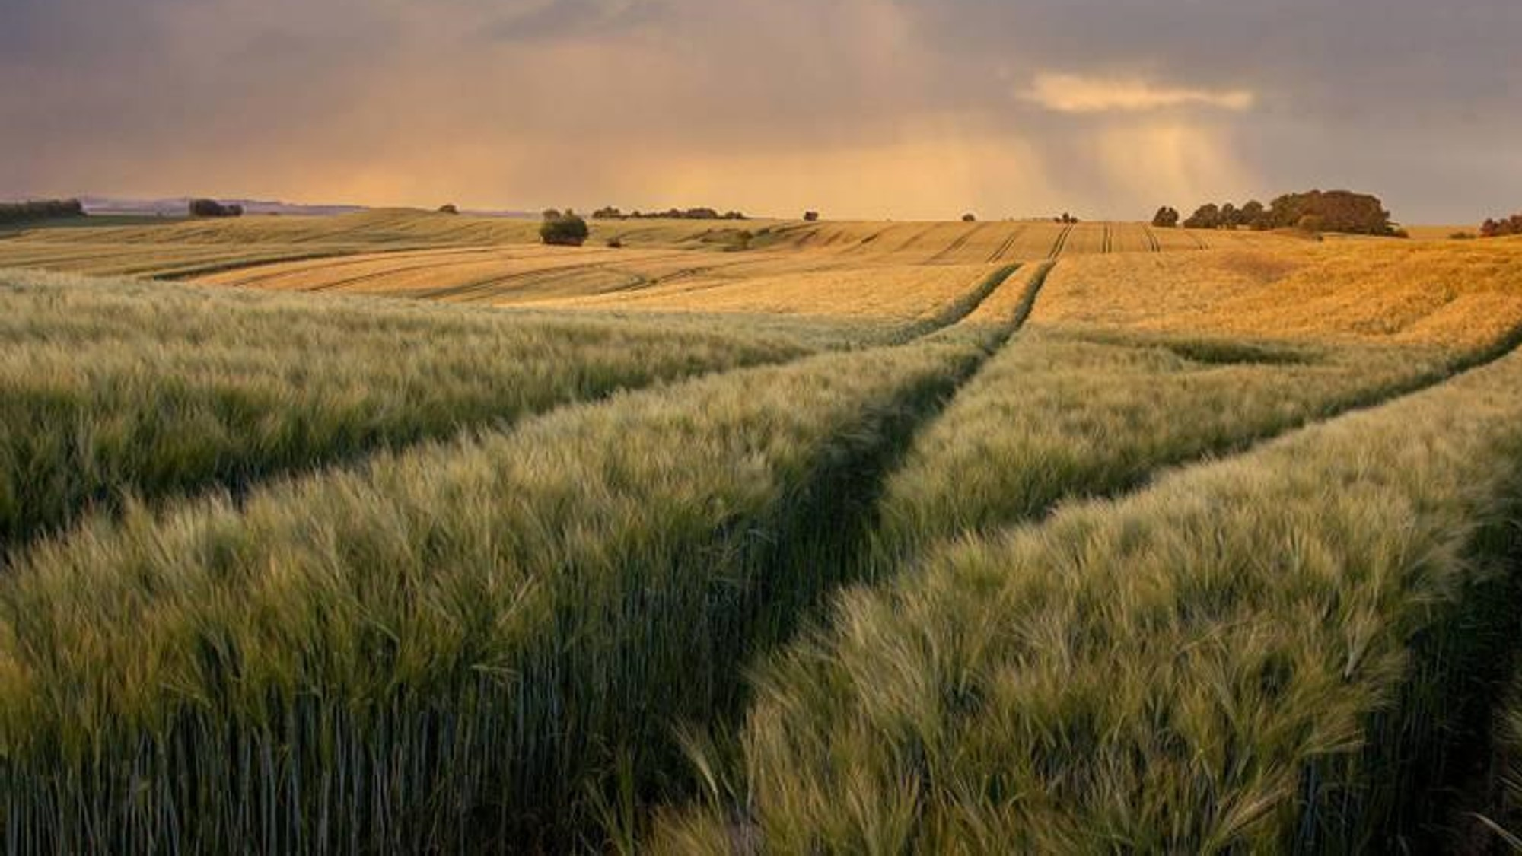
DaTA CLEANING WITH PYTHON

Slide 5

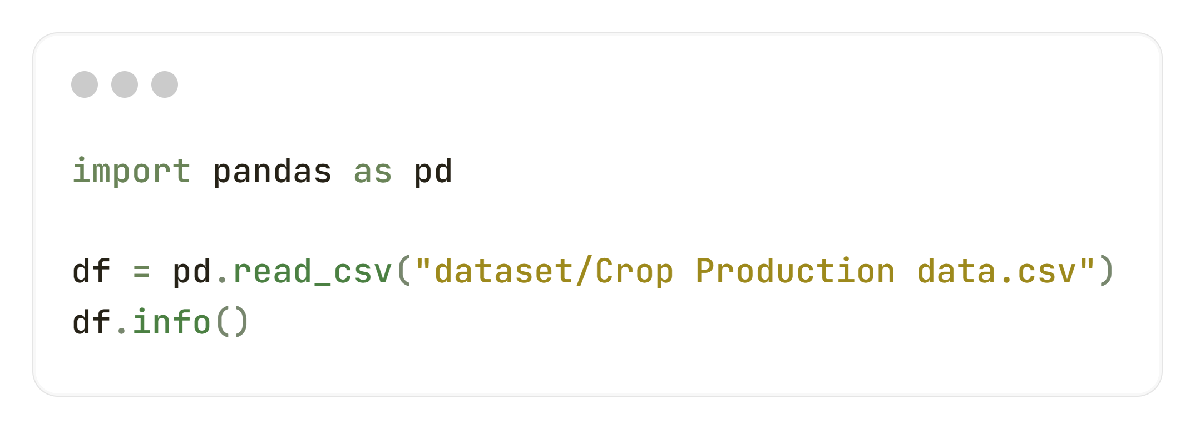
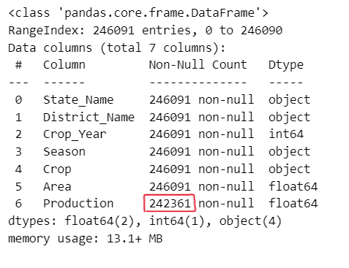
CHECK NULL VALUES
We can notice that, “Production” column has NULL values. In our dataset, total rows are 246091, out of them 242361 are Non-NULL. So, the remaining are NULL. Now, we have to remove those NULL values from dataset for better model prediction for Machine Learning.

Slide 6
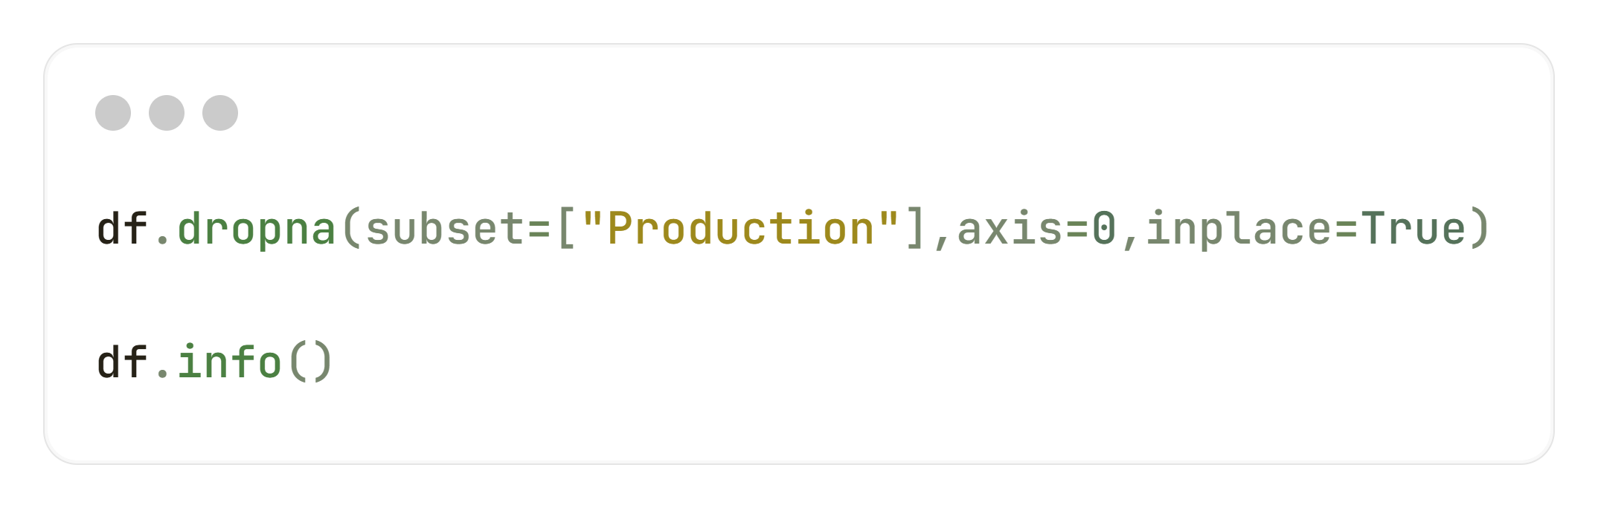
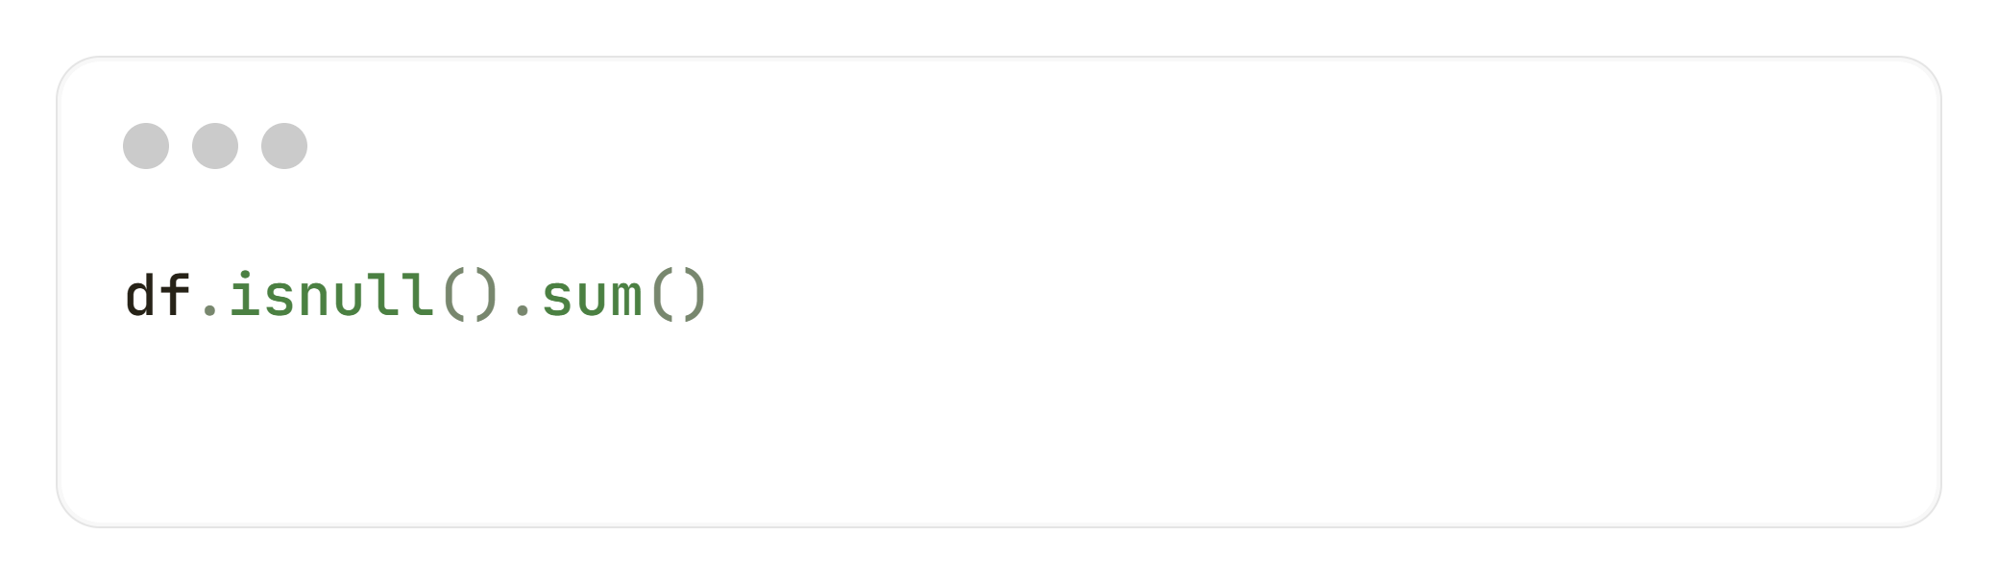
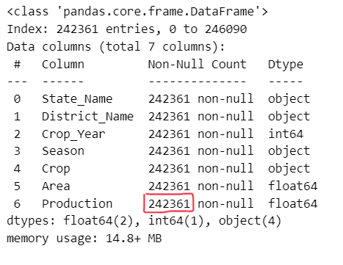
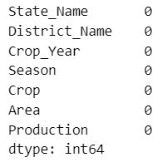
REMOVE NULL VALUES
Here, with the help of Pandas, we removed/dropped NULL values from dataset.
Now, we can see there is total 242361 entries and no NULL values present.
Also, we used Pandas isnull() and sum() function to check the number of NULL values in each columns and there is 0 NULL values in count.

Slide 7
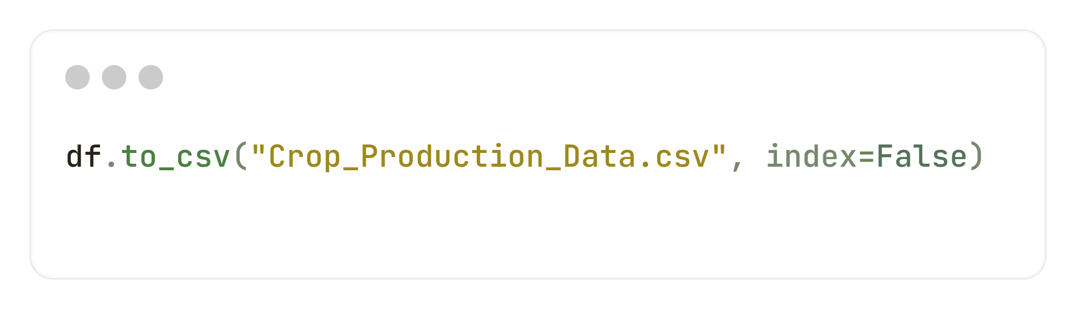
EXPORT CLEANED DATASET
Used Pandas to_csv() function to export the cleaned dataset for Data Analysis using Power BI and also for Machine Learning prediction using Python

Slide 8
DaTA ANALYSIS & VISUALIZATION WITH POWER BI

Slide 9
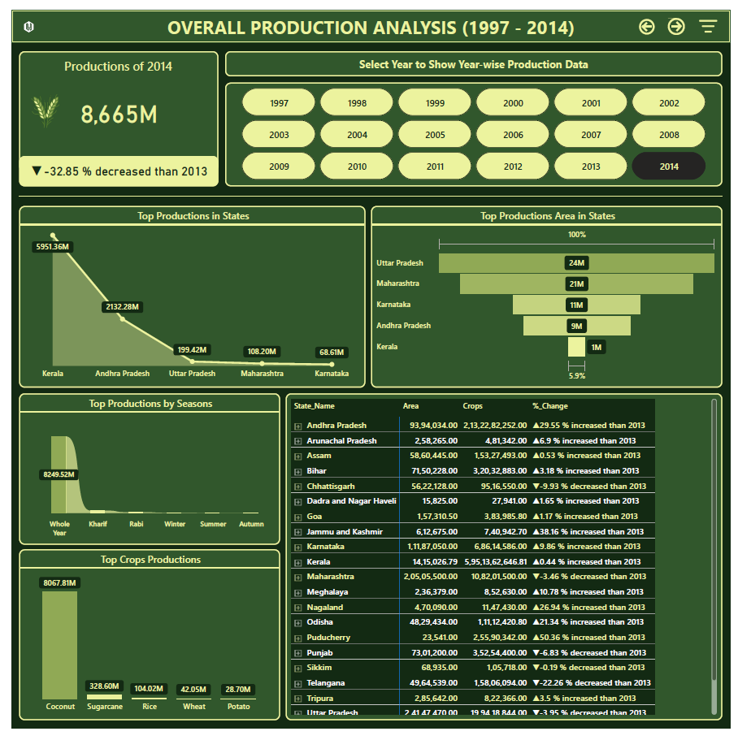
PRODUCTION ANALYSIS WITH POWER BI
By default 2014 as the “Year” will be selected in slicer. We can also select other years by selecting options.
According to selected year, it’ll show total production of the selected year, e.g. in 2014, 8665M corps produced. Also, how much production percentage increase/decrease than last year will show.
Top states will show by total productions according to selected year using area chart, e.g. in 2014, Kerala was the top.
Top seasons will show by total productions according to selected year using ribbon chart, e.g. in 2014, Whole Year was the top.
Top crops will show by total productions according to selected year using clustered column chart, e.g. in 2014, Coconut was the top.
Also depicted the tabular form of state-wise data to show Area, Crops production and % change than previous year.

Slide 10
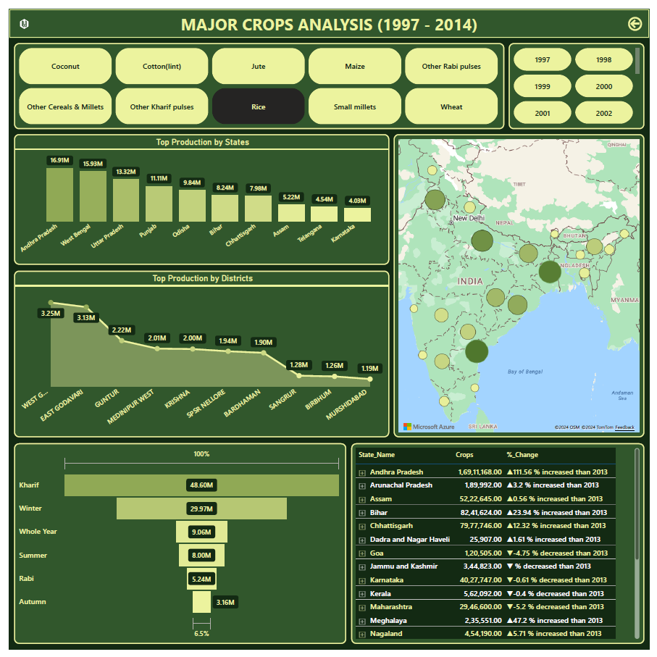
MAJOR CROPS ANALYSIS WITH POWERBI
By default 2014 as the “Year” will be selected in slicer. We can also select other years by selecting options.
By default Rice as the “Crop” will be selected in slicer. We can also select other crops by selecting options.
According to selected year and selected crop, it’ll show total production by states of the selected year and crop, e.g. in 2014 and for Rice, top state was Andhra Pradesh. Used clustered column chart to depict the data.
According to selected year and selected crop, it’ll show total production by districts of the selected year and crop, e.g. in 2014 and for Rice, top district was West Godavari. Used area chart to depict the data.
Top seasons will show by total productions according to selected year and crop using funnel chart, e.g. in 2014 and for Rice, Kharif was the top.
Also depicted the tabular form of state-wise data to show Crops production and % change than previous year according to selected year and crop.

Slide 11
Model PREDICTION for PRODUCTION USING PYTHON

Slide 12
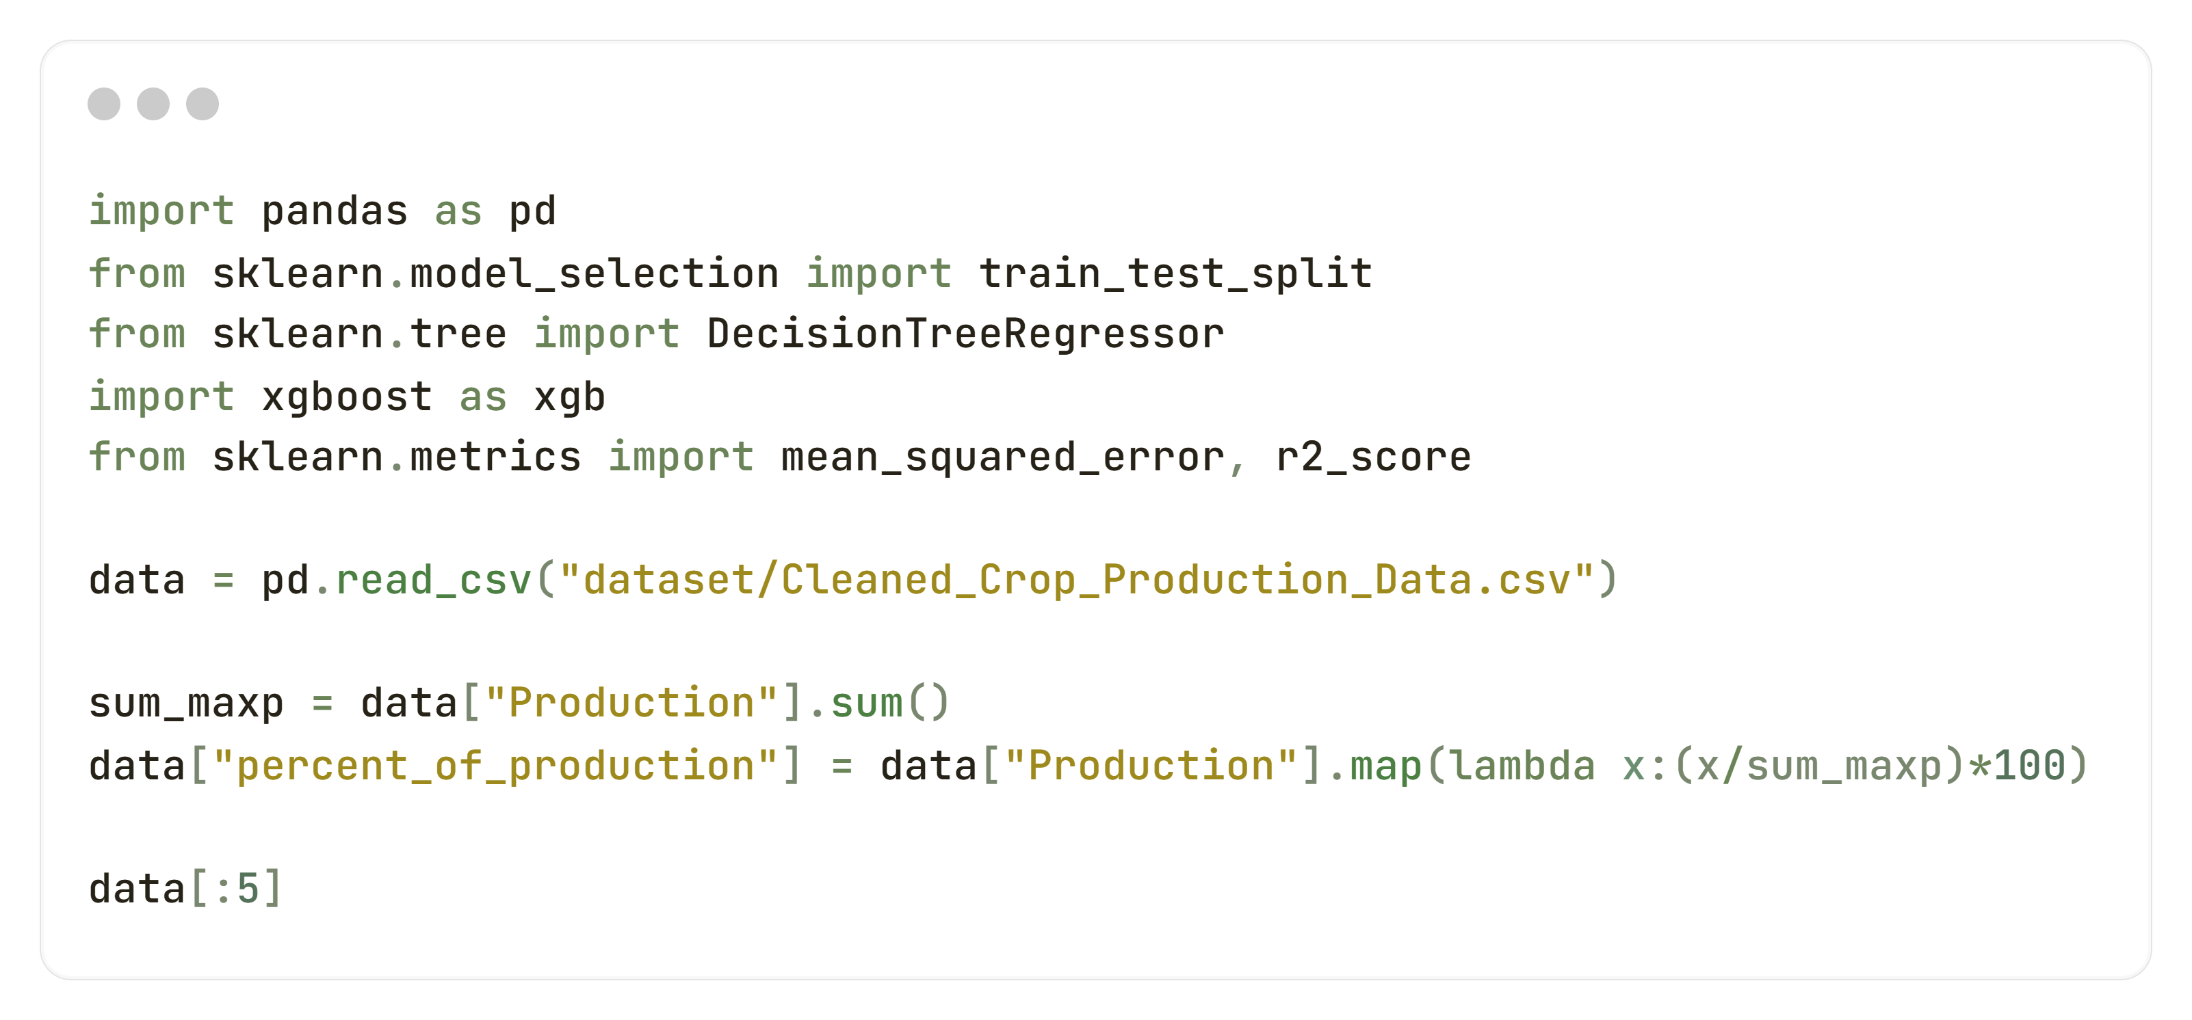
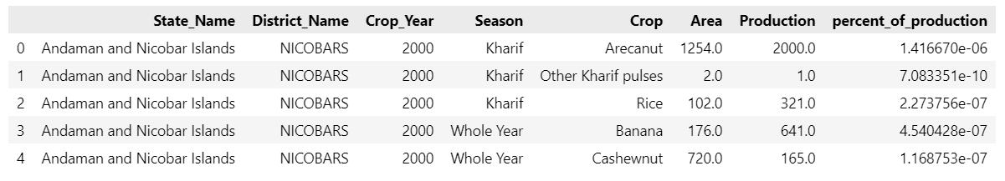
Percentage of production
We imported essential libraries and load the cleaned dataset which we cleaned at first step using python. Then we sum the values of column – “Production” and used lambda function to calculate percentage of production of each row data and made a new column named, “percent_of_production”.

Slide 13
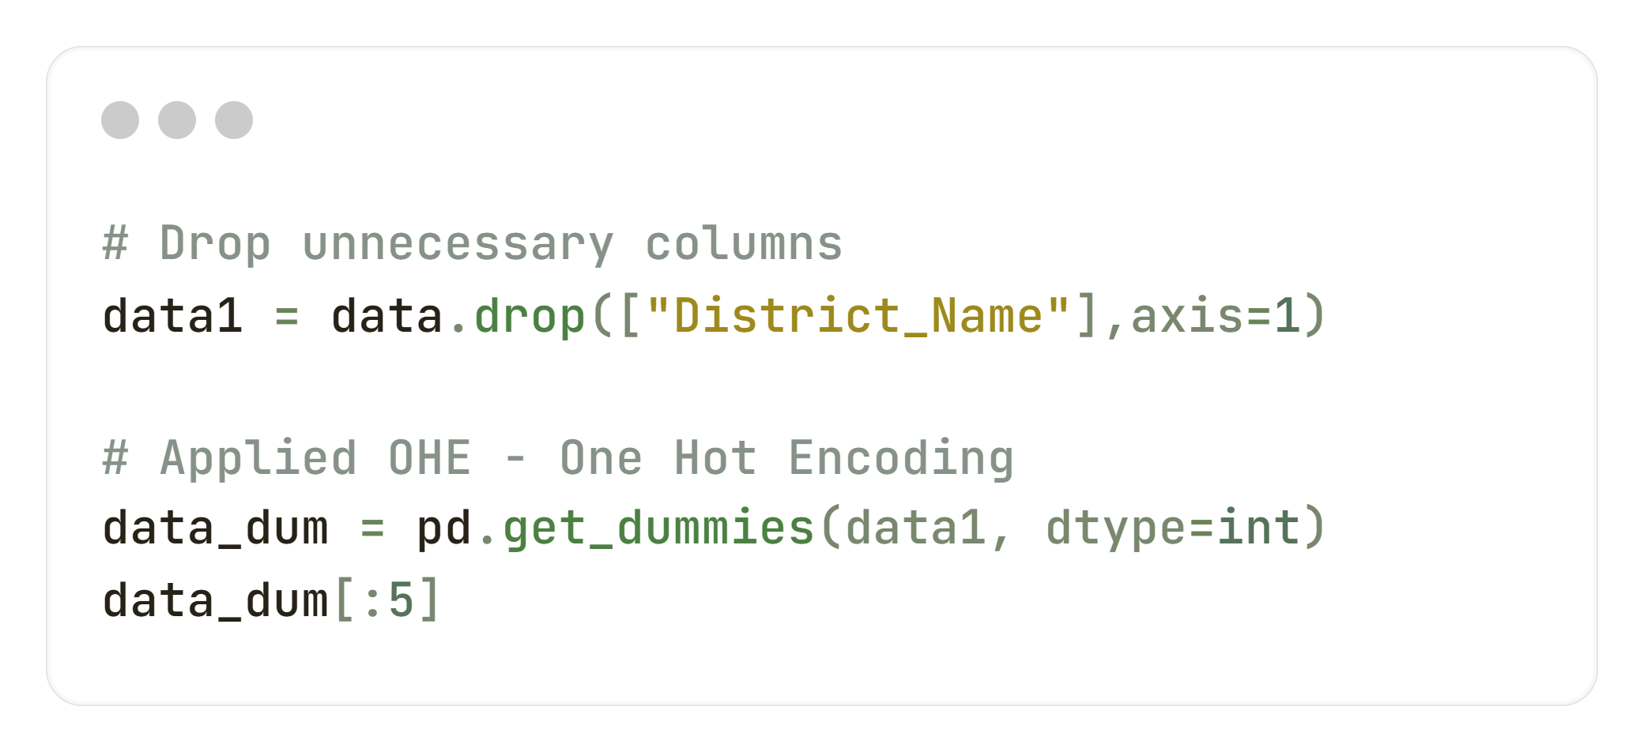
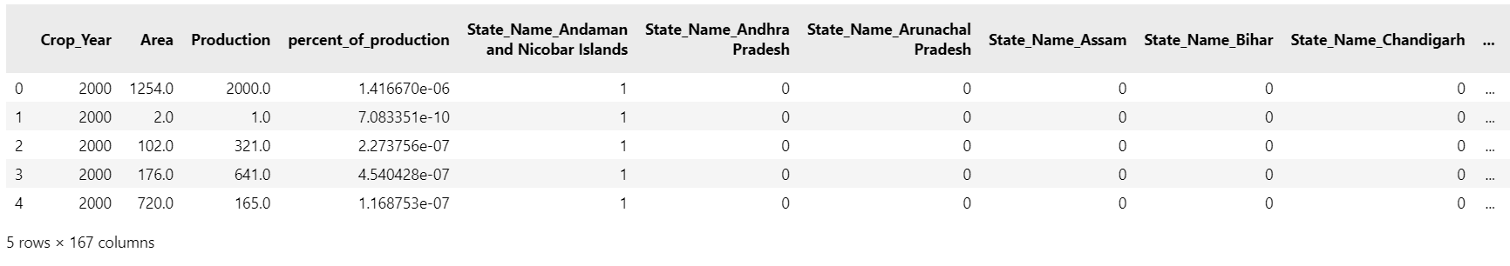
Drop unnecessary column & OHE
Here we dropped unnecessary column – “District_Name” and then applied OHE using Pandas get_dummies() method and depicted the 5 rows of dataset.
One hot encoding is a technique that we use to represent categorical variables as numerical values in a machine learning model. It allows the use of categorical variables in models that require numerical input. It can improve model performance by providing more information to the model about the categorical variable.

Slide 14
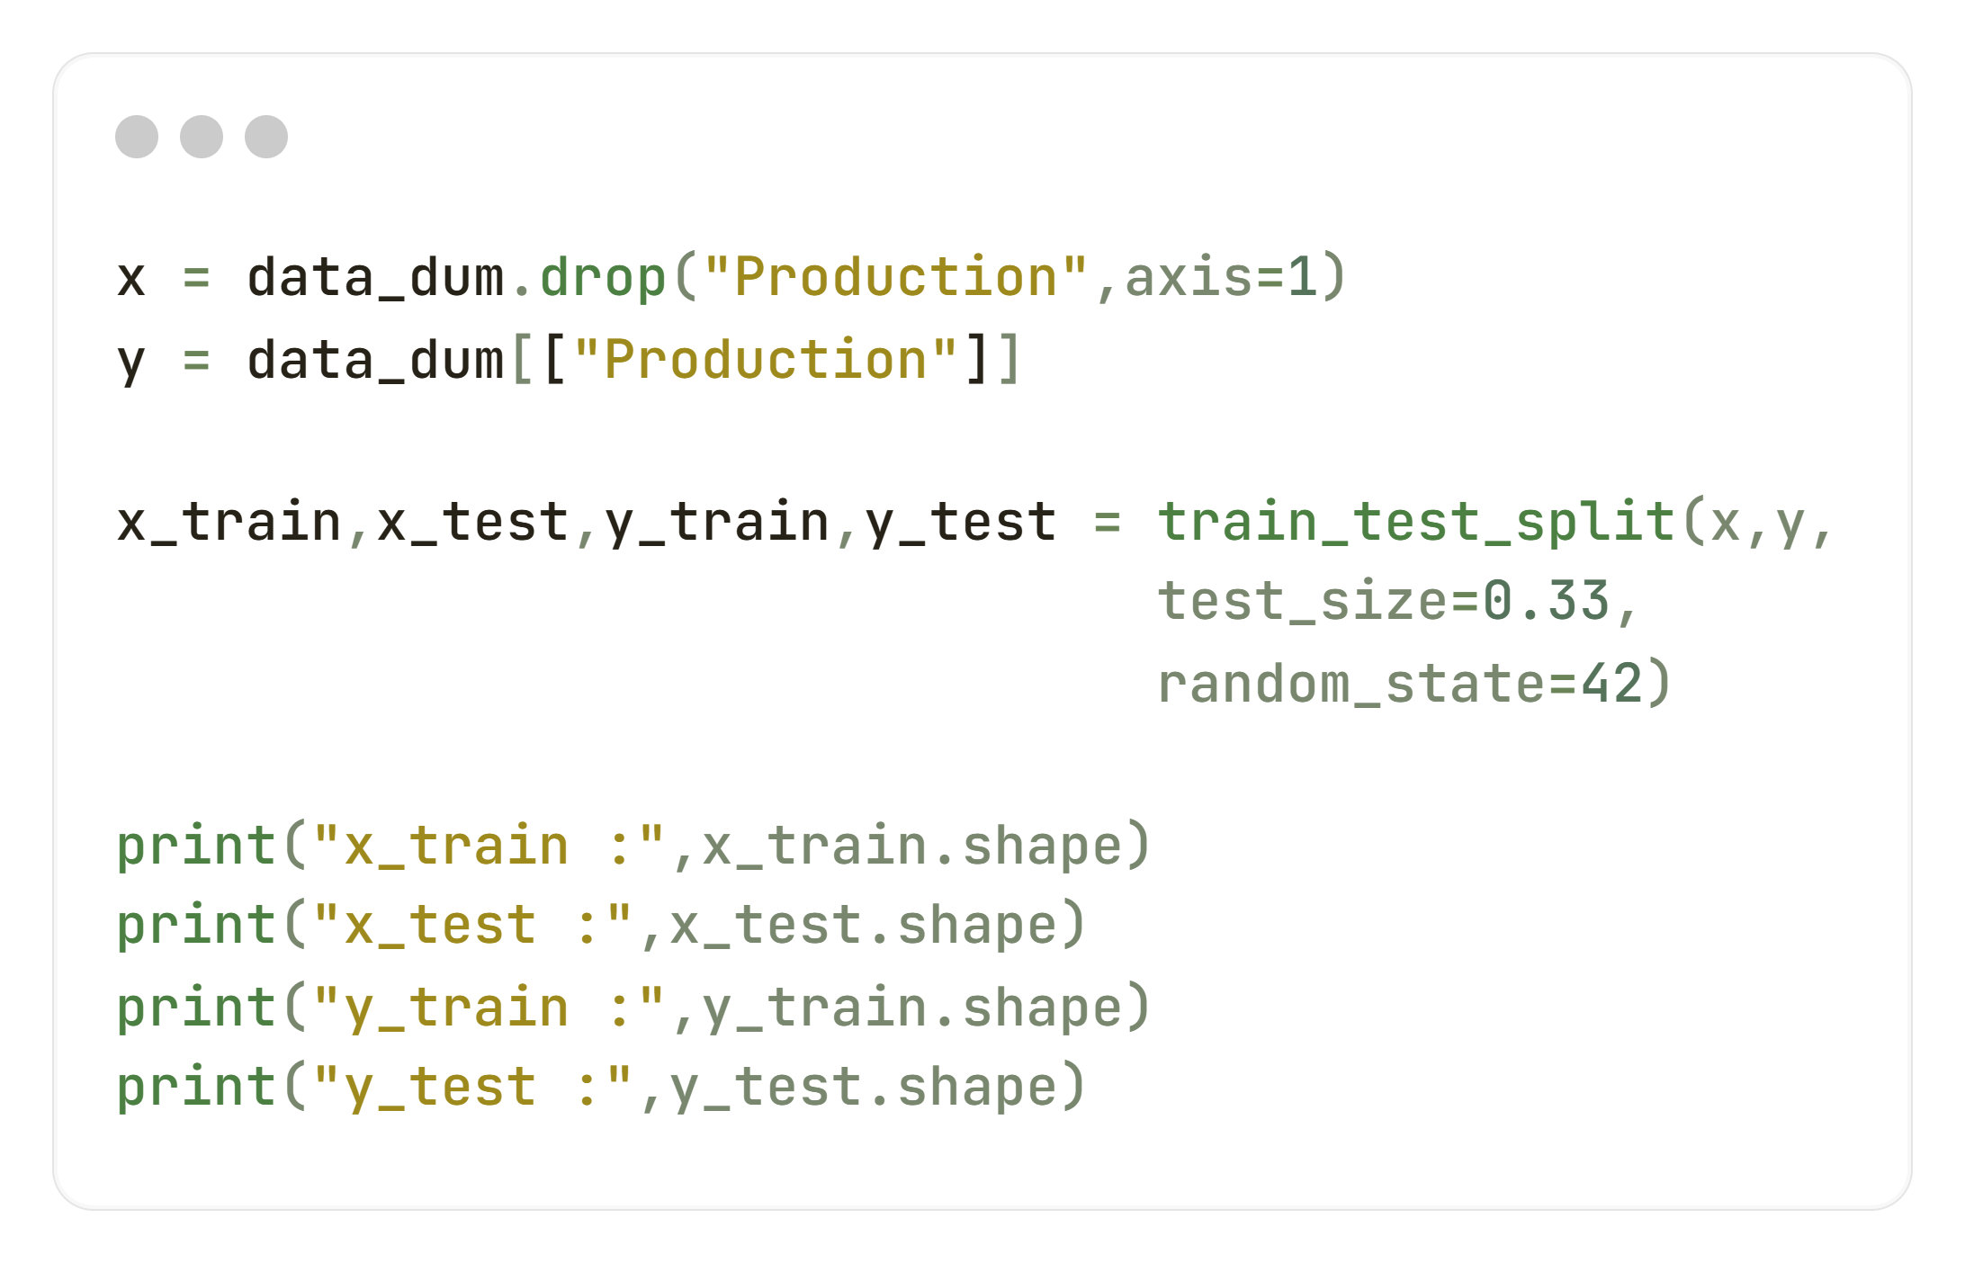
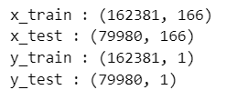
Split dataset for ml models
For training the Machine Learning models, we assign whole dataframe except “Production” column to variable “x” and for testing we assign only “production” column as dataframe to variable “y”.
Then we used “train_test_split” method of scikit-learn library to split the data into train and test format.
Here is the shape of train & test dataset.

Slide 15
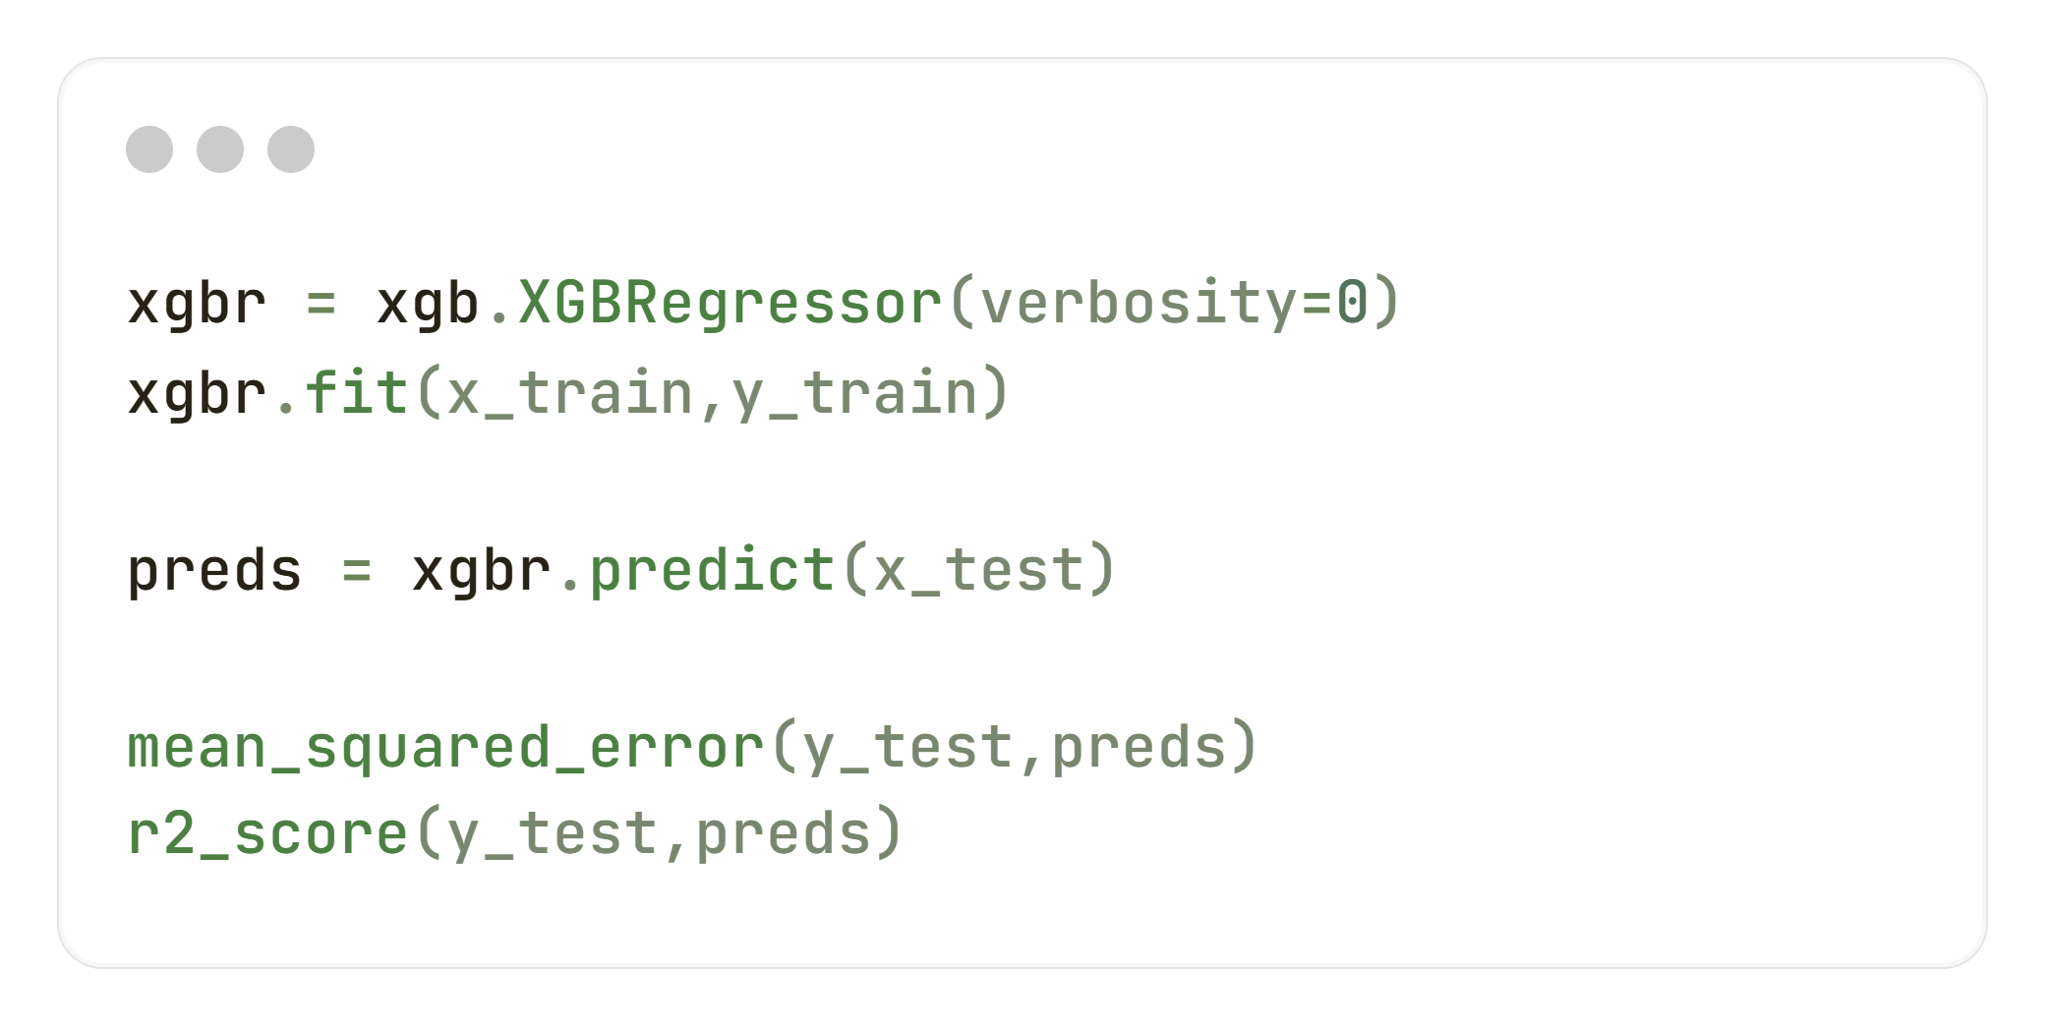
ML Models - XGB prediction accuracy
Here, we used XGB Regressor model to predict the crops productions.
It gives us :
MSE -> np.float64(14240867412939.752)
R2 Score –> 0.95

Slide 16
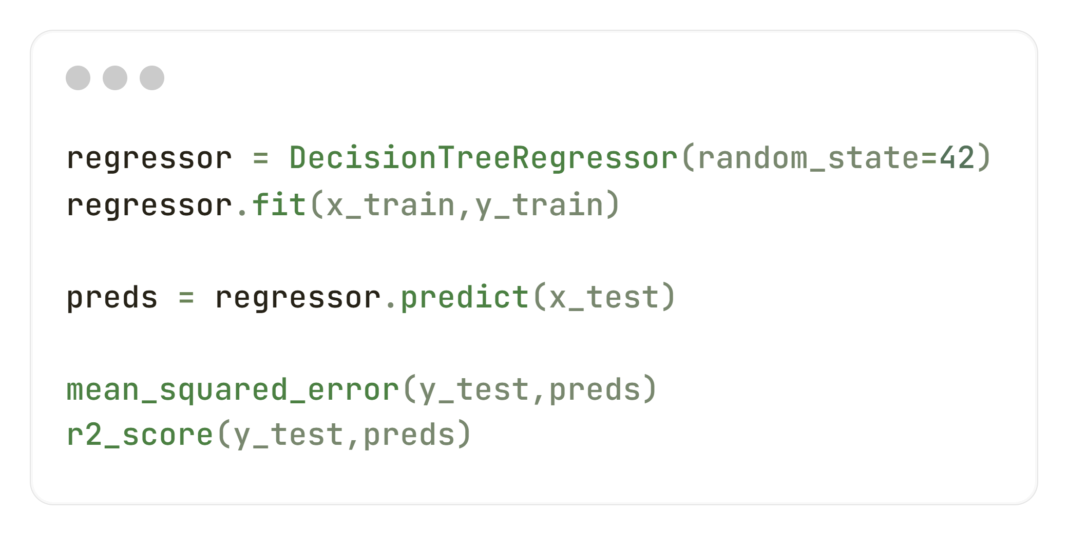
ML Models – Decision tree prediction accuracy
Here, we used Decision Tree Regressor model to predict the crops productions.
It gives us :
MSE -> np.float64(378537510326.2657)
R2 Score –> 0.99

Slide 17
conclusion
We have noticed that, Decision Tree providing more accuracy than XGB. So, we will use Decision Tree model for Machine Learning prediction for production of crops.

Slide 18

Thank you
Akashdeep Dam​​​
akashdeepdam@gmail.com
UNID : UMIP20537

